Slide 1

JACKFRUIT PROBLEM
MEMBERS
MAYANK S. KALAME
SRN:PES1UG25CS297
ROLL NO:1
MADHAVAN.R
SRN:PES1UG25CS198
ROLL NO:43
MADIPALLI DIVYA SRI
MEGHA ANN
SRN:PES1UG25CS728
ROLL NO:36
SRN:PES1UG25CS207
ROLL NO: 47

Slide 2

PROBLEM STATEMENT
This project presents an innovative system that converts live sound or recorded music into dynamic fractal visuals. The system continuously analyzes key audio features—including frequency spectrum, amplitude peaks, pitch variations, and rhythm patterns—using digital signal processing techniques. These extracted features are then mapped to different fractal parameters such as recursion depth, angle variations, branching structures, color gradients, rotation, and motion intensity
This creates a visually immersive environment where mathematical patterns behave like living organisms synchronized with the sound. The system blends concepts from mathematics, art, and audio engineering, resulting in a unique form of digital expression where each soundscape produces a one-of-a-kind fractal journey.

Slide 3
APPROACH USED:
The system uses a three-stage approach: (1) audio uploading, (2) audio feature extraction, and (3) visual fractal generation on a dashboard.
Audio Feature Extraction
From the audio, multiple features are computed using Librosa:
a. RMS Energy/Loudness (Amplitude)
Audio is split into small frames. RMS (root mean square) for each frame gives the instant loudness. Convert RMS to decibels to show how intensity varies with time. This controls fractal size, branch thickness, or animation speed.
b. Pitch Extraction (Frequency)
The YIN algorithm detects the fundamental frequency of the audio. Pitch values are tracked in real-time. This controls color shifts, rotation, and angle changes in fractals.
c. Spectral Features
STFT gives the frequency spectrum.
Magnitude and frequency bins help identify how sound energy is distributed. This can be used for higher-order fractal behavior, smooth animations, and outer patterns.

Slide 4
Dynamic Fractal Visualization
Two fractals are displayed on the dashboard:
Fractal A – Branching Tree Fractal
Branch length scales with loudness Branch rotation changes with pitch. The fractal “grows” or “shrinks” based on amplitude.
Fractal B – Duffing Fractal
Spiral radius adjusts with amplitude. Speed of rotation changes with pitch. Colors evolve using spectral intensities.
Both fractals update frame-by-frame as the audio plays, creating a real-time audio-visual experience.

Slide 5
Dashboard Integration
The system combines everything into one interface:
Audio is processed in the background.
Features stream into the visualization engine.
Both fractal options are displayed side by side, from which you can choose one.
A timeline or graph can show how parameters of sound can affect the fractal.
This makes the dashboard an interactive fusion of:
✔ sound
✔ mathematics
✔ generative visuals

Slide 6
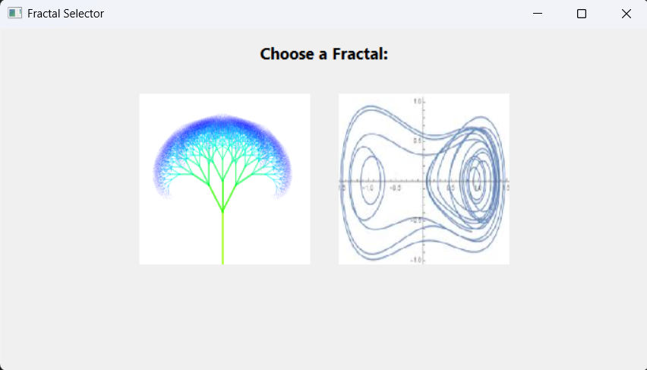
SAMPLE INPUT

Slide 7
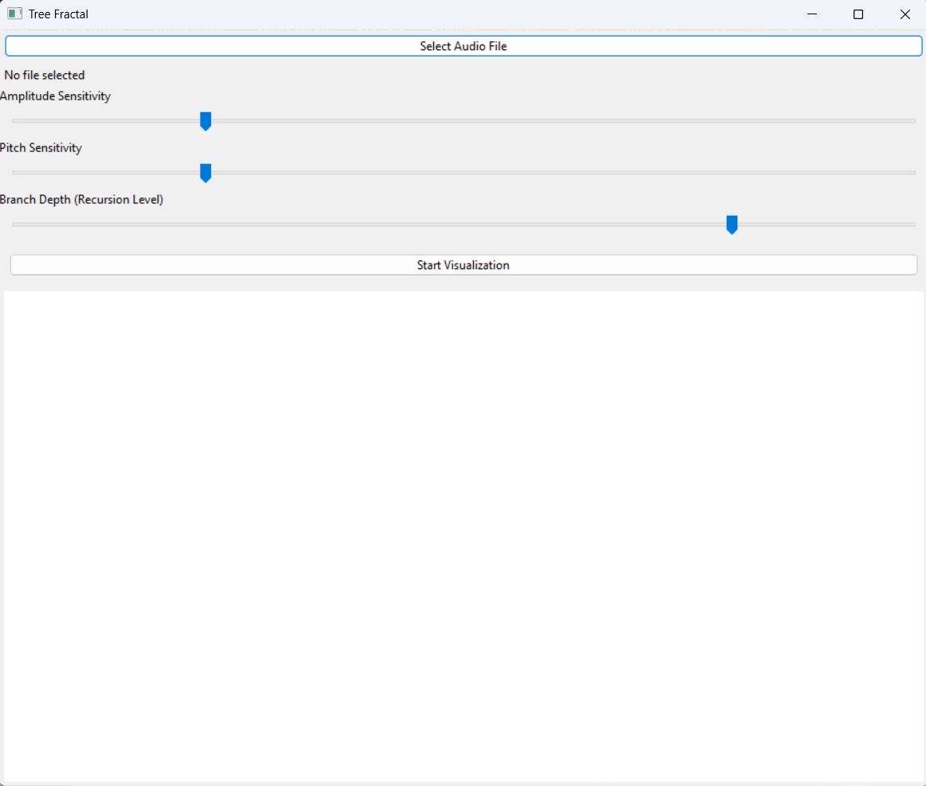
Choosing Tree Fractal

Slide 8
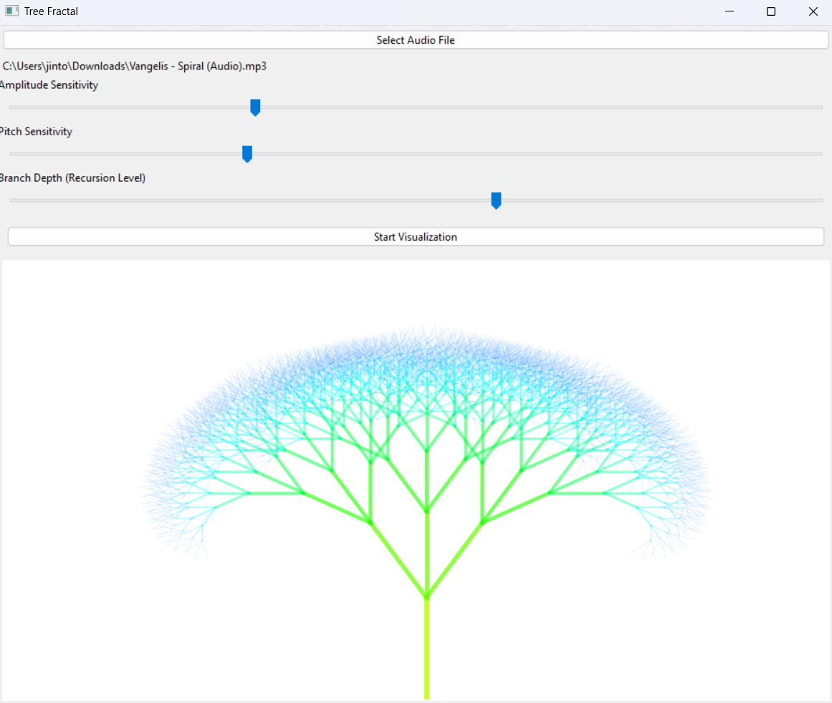
SAMPLE OUTPUT
Loading file and adjusting parameters

Slide 9
CHALLENGES
Extracting Meaningful Audio Features: It was a major challenge while determining which audio features would be most effective for controlling the fractal parameters. It took time to experiment and find features that produced changes in the visualization that were both logical and visually meaningful.
Designing and Structuring the GUI: Creating the GUI required careful organization. Arranging the buttons, sliders, and labels in a clear layout—and ensuring each component performed its intended function—proved more involved than expected.
Understanding the Functional Flow: With several functions interacting throughout the program, understanding the sequence of operations was sometimes difficult. Ensuring the functions worked together properly was essential for the GUI and overall program behavior to remain consistent.
Animating the Fractals: Keeping the fractals animated instead of just showing a still image was harder than expected. Making Matplotlib’s animation work smoothly with wxPython took quite a bit of effort.
Synchronizing Real-Time Audio With the Animation: The fractal responds to real-time audio, where the updates have to happen smoothly, without the animation freezing or falling behind whenever the audio or slider values change.

Slide 10
IMPROVEMENTS
Additional Fractal Types: More fractal options could be added so users have a wider range to explore. This would make the project more engaging and give people the chance to experiment with different visual patterns.
Real-Time Audio Playback: Playing the audio at the same time as the fractal animation would make the experience more intuitive. Users would be able to see how the fractal reacts to the sound while actually hearing it, which creates a stronger connection between the audio and the visuals.
Performance Optimization: The fractal generation could be optimized so it runs faster and doesn’t slow down the animation. Reducing unnecessary delays or improving how the calculations are handled would help the program feel smoother overall.
Enhanced GUI: The interface could be made more interactive and user-friendly by adding things like extra sliders and play/pause/reset buttons. Improving the layout and visuals would also make the program easier and more enjoyable to use.

